Slide 1
Insurance Board
CSR-24 Client Portal Training

Slide 2
Overview
− Introduction to CSR-24 Client portal
− Options for obtaining a Certificate of Insurance or Evidence of Property
− Using the CSR-24 Client Portal
− Resources

Slide 3
Options on how to obtain Certificate/EOP
Certificate/Evidence of Property
Use CSR-24 Client Portal
Email Insurance Board certificates@insuranceboard.org

Slide 4
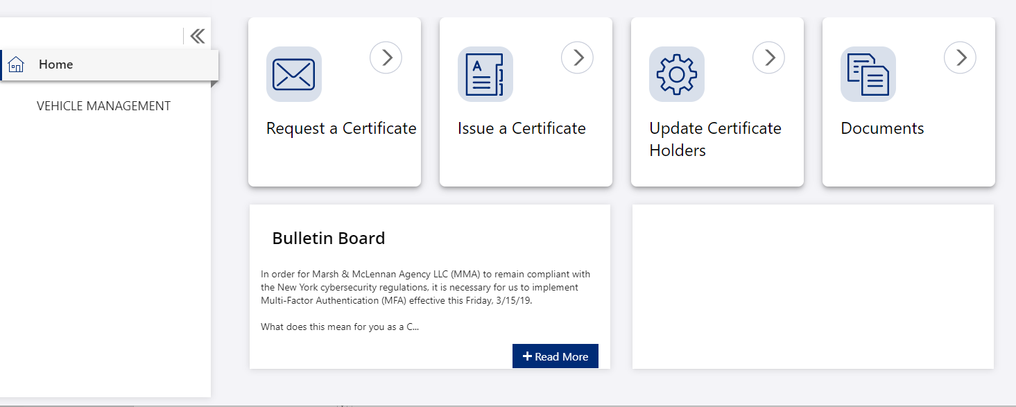
CSR-24 Client Portal
Web address - https://portal.csr24.com/mvc/1573544320
Log in and you will be brought to your home page.
.

Slide 5
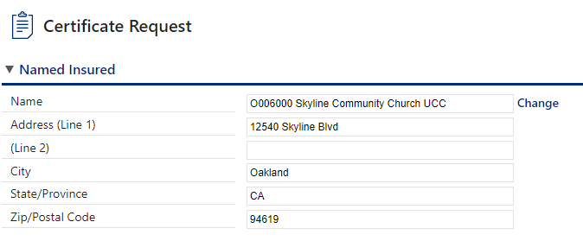
CSR-24 Client Portal
Option 1- Request a certificate
The Named Insured in the Name line will be specific to your organization.
Click on Change to find the correct Named Insured to be reflected on the certificate.

Slide 6
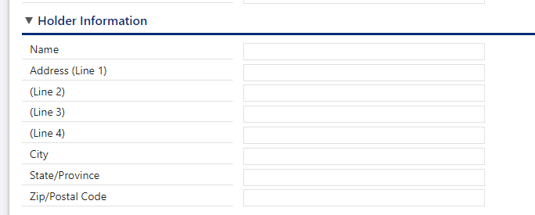
CSR-24 Client Portal Contd.
Enter holder information

Slide 7
CSR-24 Client Portal Contd.
Enter Coverage information
Limit Required section is optional.
Be sure to click boxes for Additional Insured or Waiver of Subrogation if needed.

Slide 8
CSR-24 Client Portal Contd.
Enter delivery information
Enter your email address an add additional notes
Click submit

Slide 9
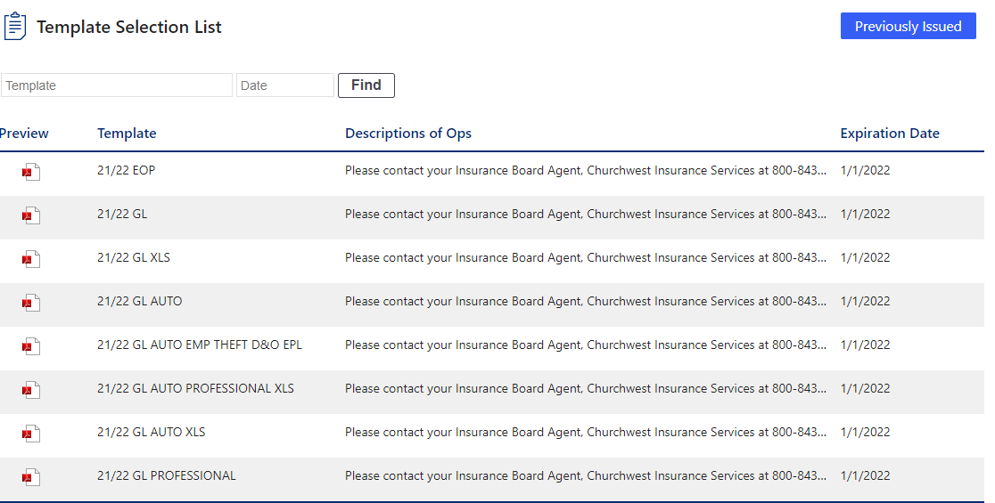
CSR-24 Client Portal Contd.
Option 2 – Issue a Certificate
You may search for previously issued certificates to reissue or amend a certificate.
To issue a new certificate select the template that shows coverage to be evidenced.

Slide 10
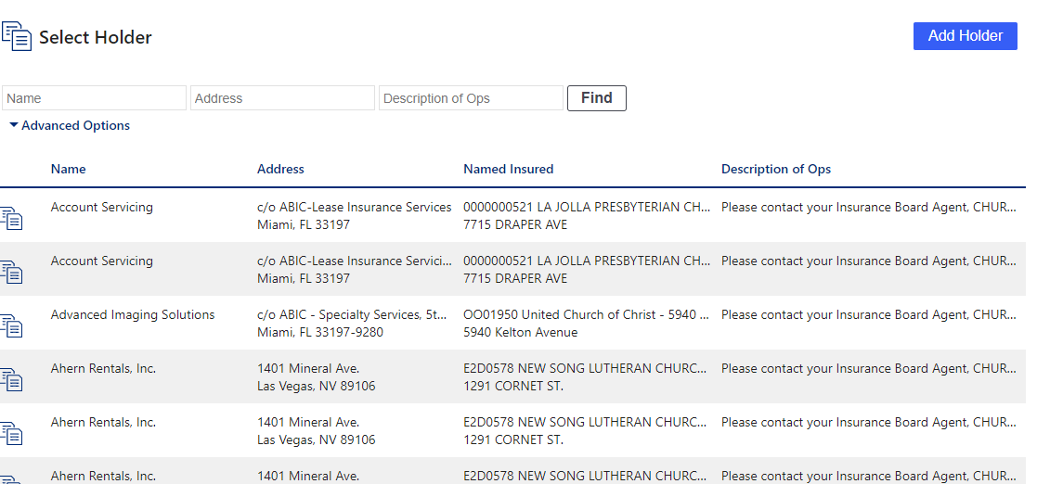
CSR-24 Client Portal Contd.
Click on the template name. EX. 21/22 GL
A list of holders will appear that are connected to that particular template.
You may either search for an existing holder or click add holder to enter new holder information.

Slide 11
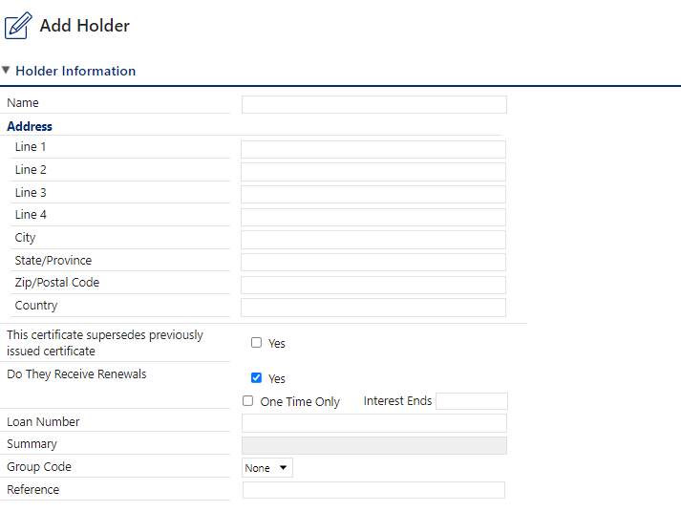
CSR-24 Client Portal Contd.
When you click on add holder you will be prompted to enter all necessary information.
Holder information
If certificate holder should receive a renewal cert check box

Slide 12
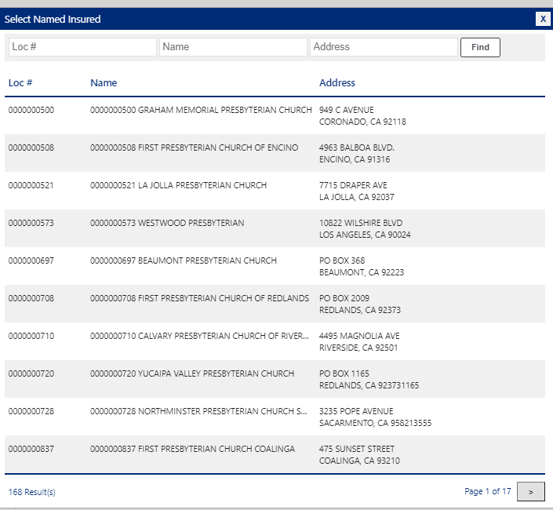
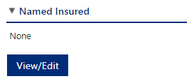
CSR-24 Client Portal Contd.
Select Named Insured from drop down box.

Slide 13
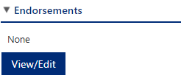
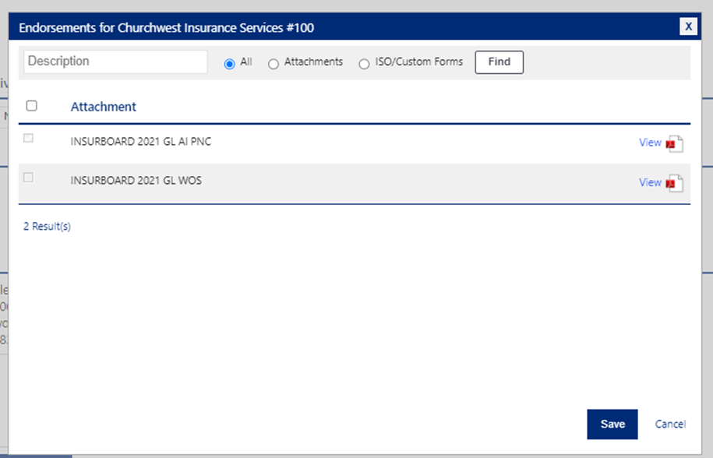
CSR-24 Client Portal Contd.
If Additional Insured or Waiver of Subrogation status is required, use the drop down box to indicate.
If endorsements are needed to accompany the certificate click View/Edit and select those needed and click Save

Slide 14
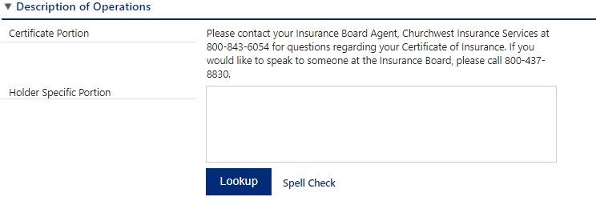
CSR-24 Client Portal Contd.
Description of Operations provides a way to add additional language, if required, to the certificate by using the Lookup feature.

Slide 15
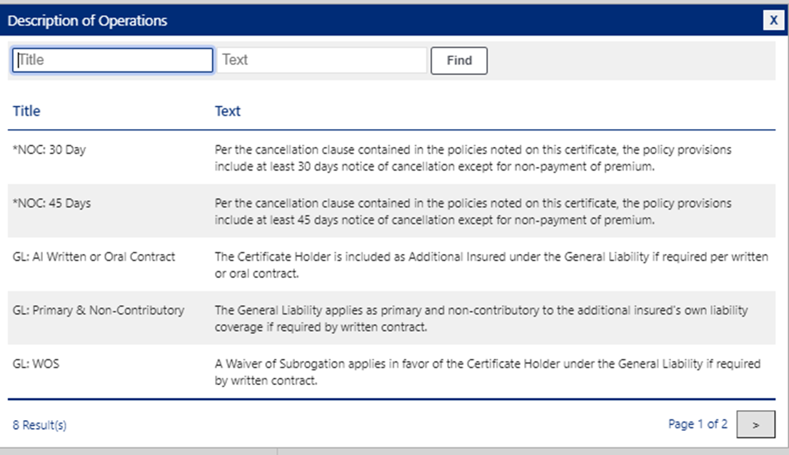
CSR-24 Client Portal Contd.
All wording is assigned by the Account Manager to the system based on the insurance policies. If you are required to add language and you do not see it on the list, please contact certificates@insuranceboard.org.

Slide 16
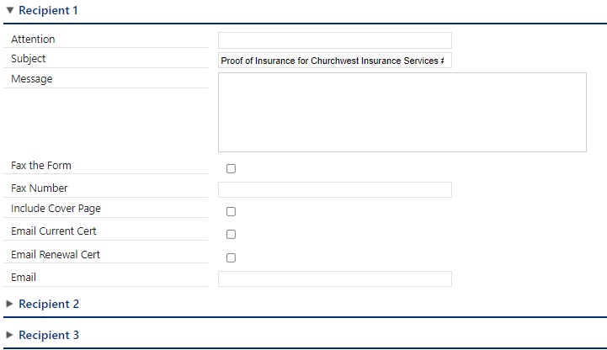
CSR-24 Client Portal Contd.
Enter delivery information, fax or email, up to three recipients.
Be sure to check both email current and renewal certificate.

Slide 17
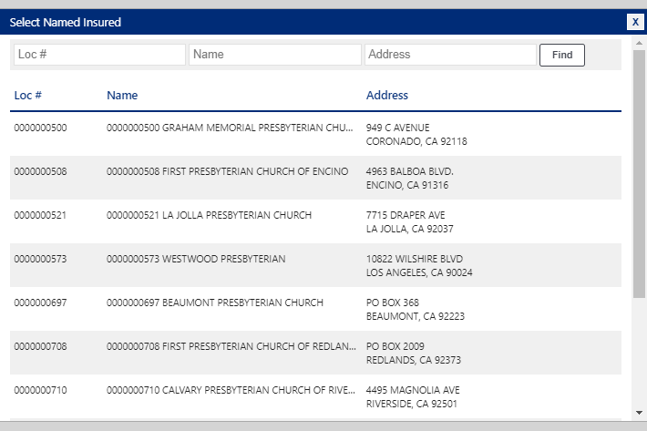
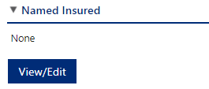
CSR-24 Client Portal Contd.
If you would like confirmation the certificate has been issued enter your email address and check button.
Click Submit
The same steps apply for Evidence of Property with two exceptions. First, you will need to select the Named Insured from View/Edit

Slide 18
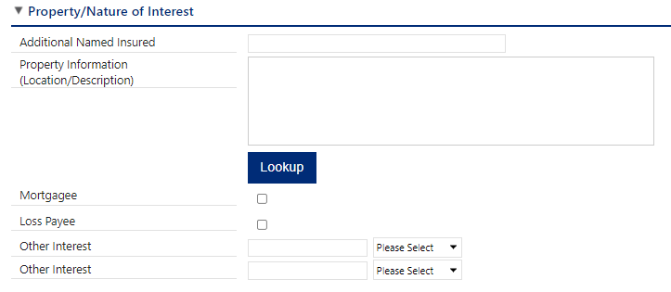
CSR-24 Client Portal Contd.
Second, add the following in the Property/Nature of Interest section.
Property blanket limit, deductible, and Special causes of loss includes theft. This information will be provided to you by your organization.
Here you will enter:
Blanket Limit: XXXX
Deductible: XXXX
Special Causes of Loss includes theft

Slide 19
Resources Email Certifcates@Insuranceboard.org CSR-24 Client Portal usage document in welcome email from Paula Hutchison

